Slide 1
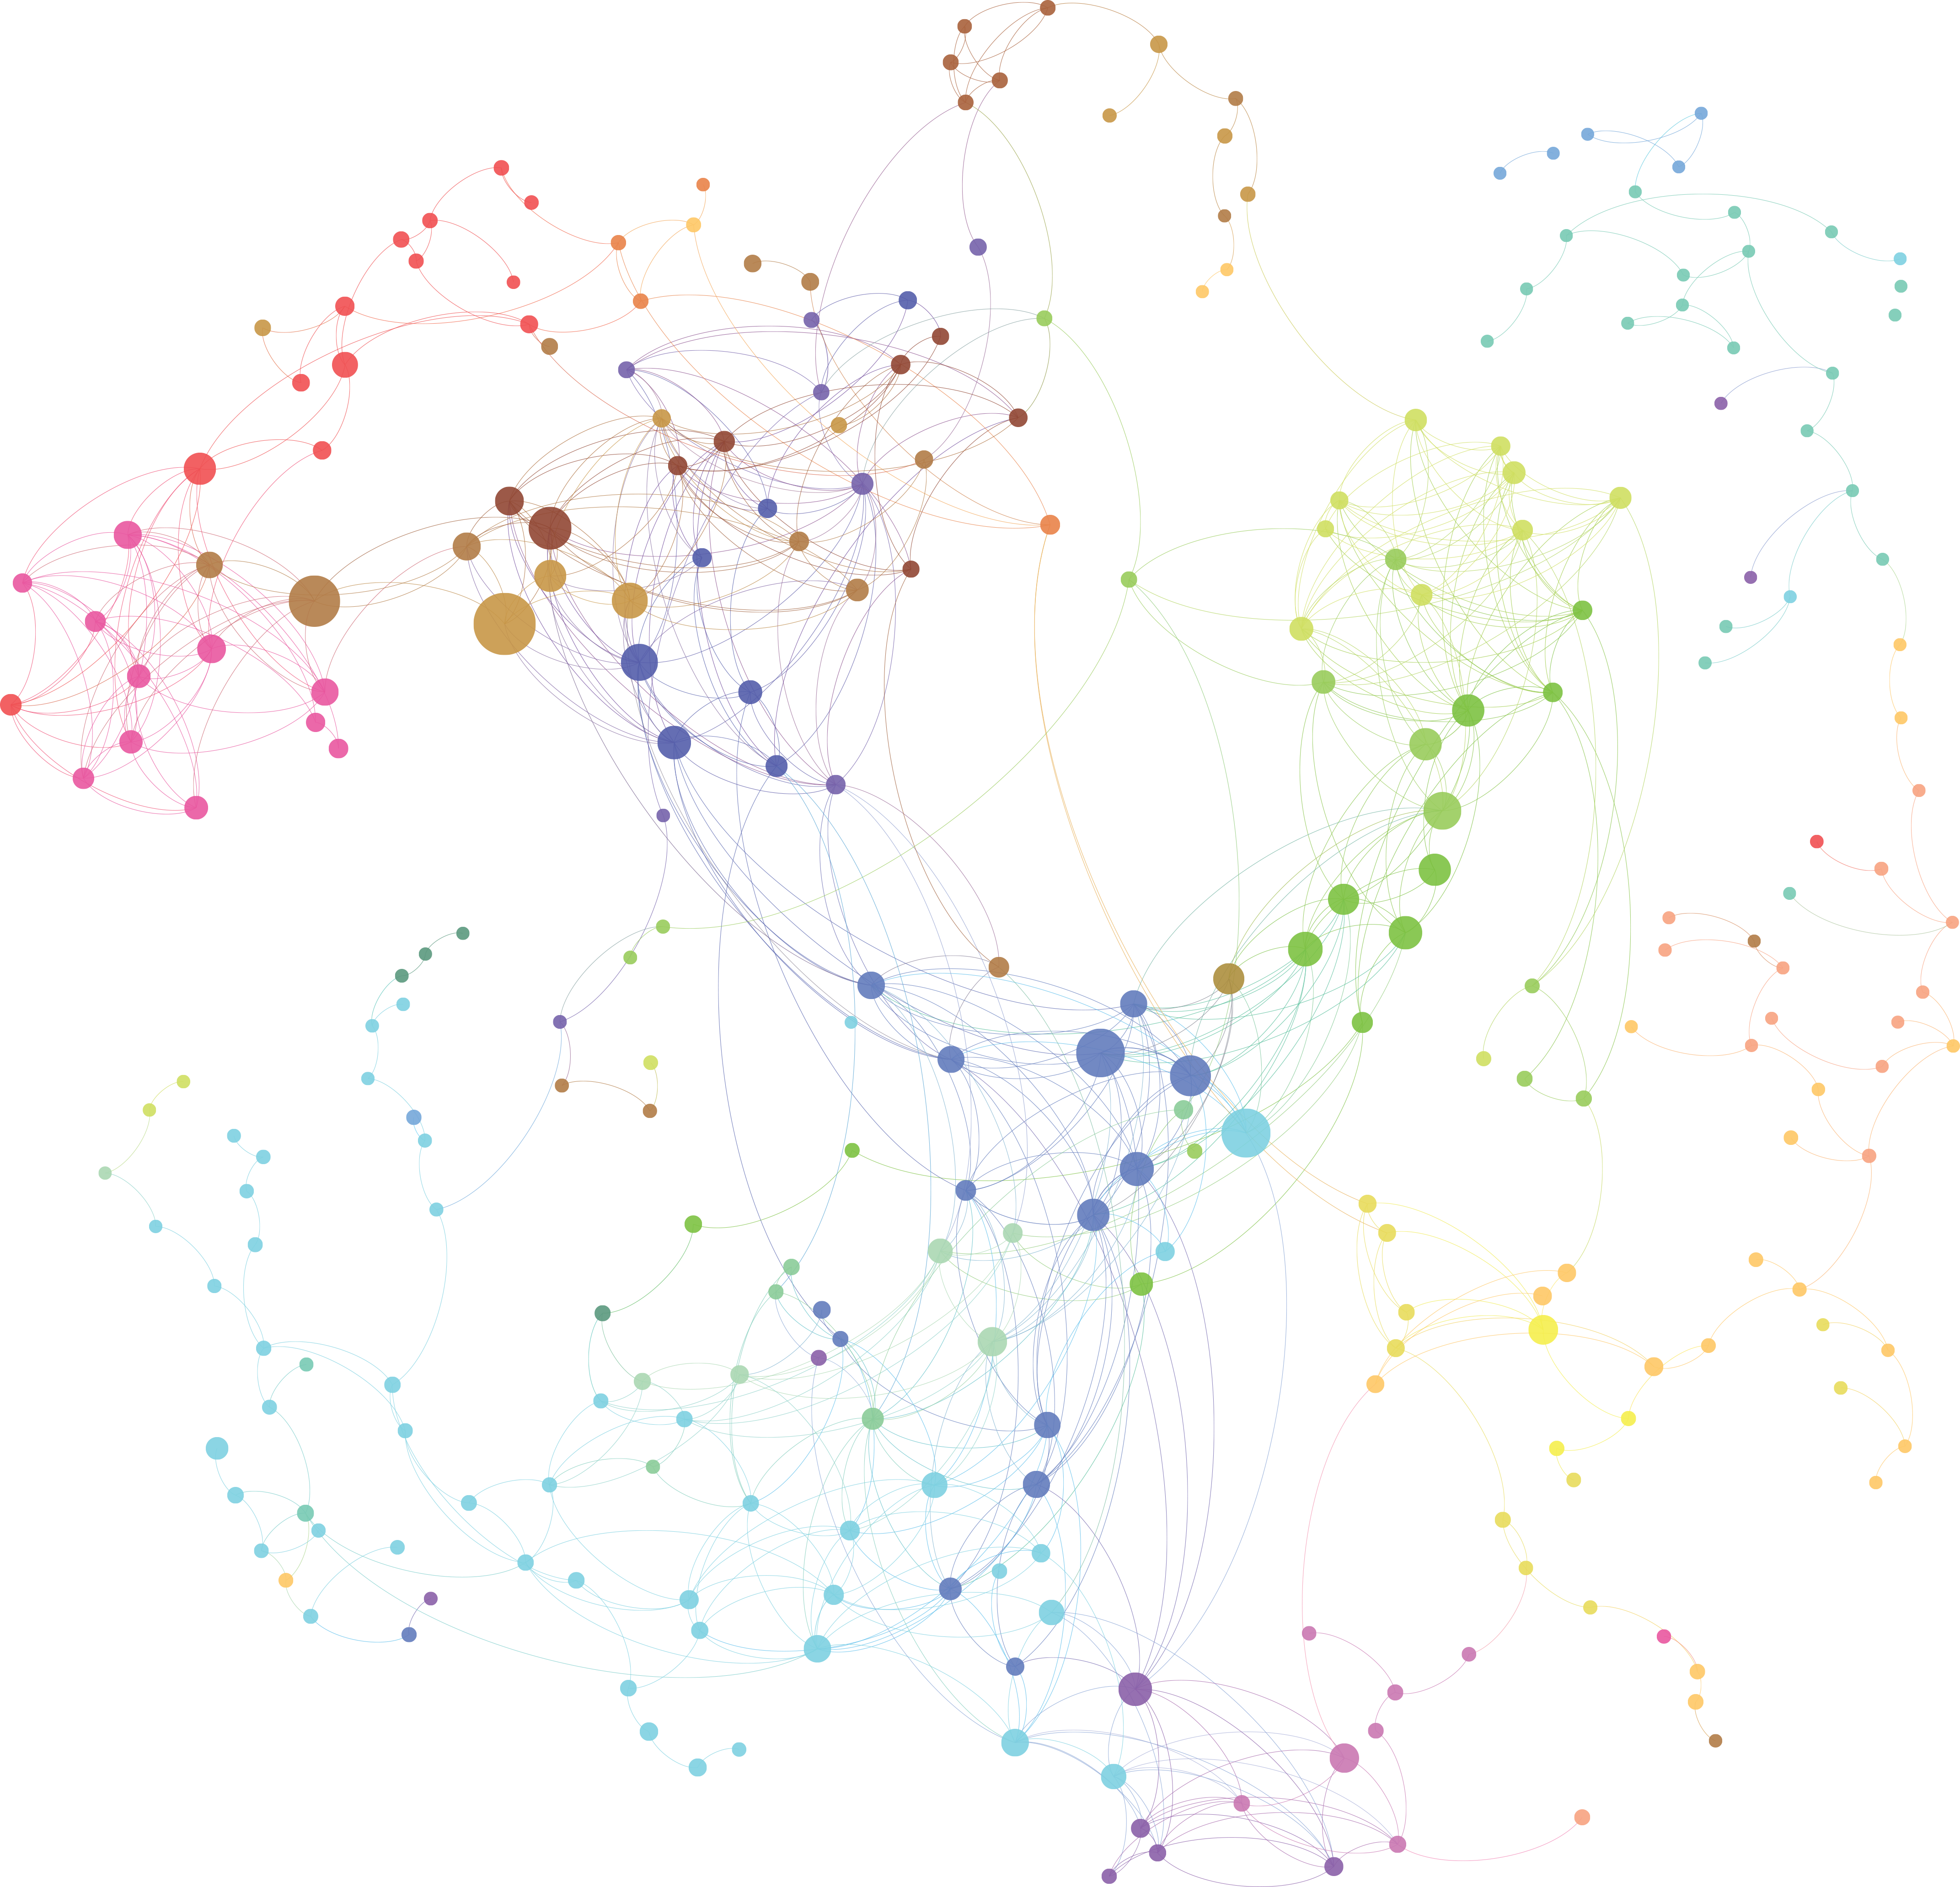



Shared Mobility as a First-/Last-Mile Solution
Using New York City taxi data to
develop applicable tools for Riyadh
Team members: Jon Campbell, Corinna Li

Slide 2
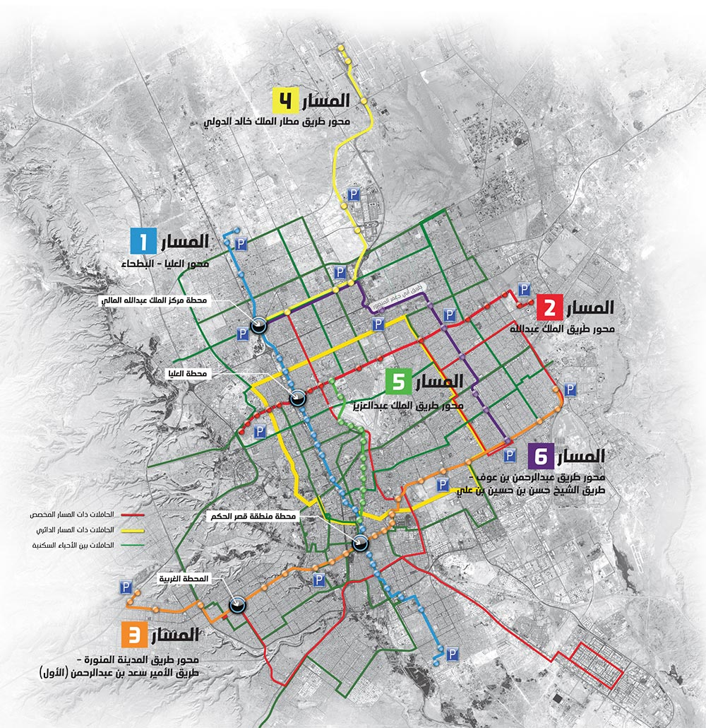
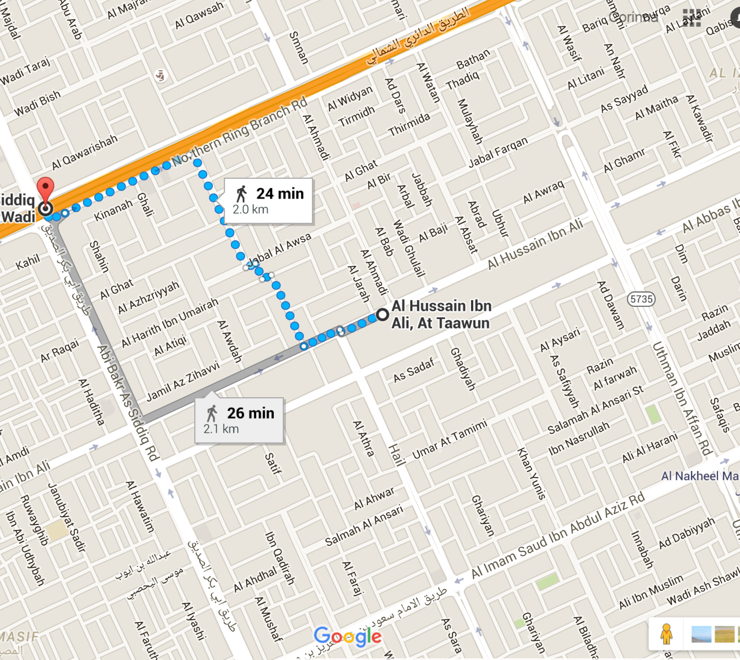
BACKGROUND
Without a good a good first-mile/last-mile solution, public transit will face challenge in adoption.
This consideration is especially crucial for Riyadh, given the hot climate, insufficient infrastructure for walking & biking, and the cultural preference towards driving.
The first- and last-miles will likely have to be solved wzith a motorized solution.
In addition to on-demand mini-buses proposed by the ADA, taxis will likely play a strong role too.
To further Riyadh’s goals of reducing congestion and pollution, let’s think about how trip-sharing can reduce vehicles needed to make the first- and last-mile trips.
Due to lack of Riyadh’s taxi data, we will conduct the exercise using New York City’s data, with aims to develop tools and methods that can be applied to Riyadh.

Slide 3
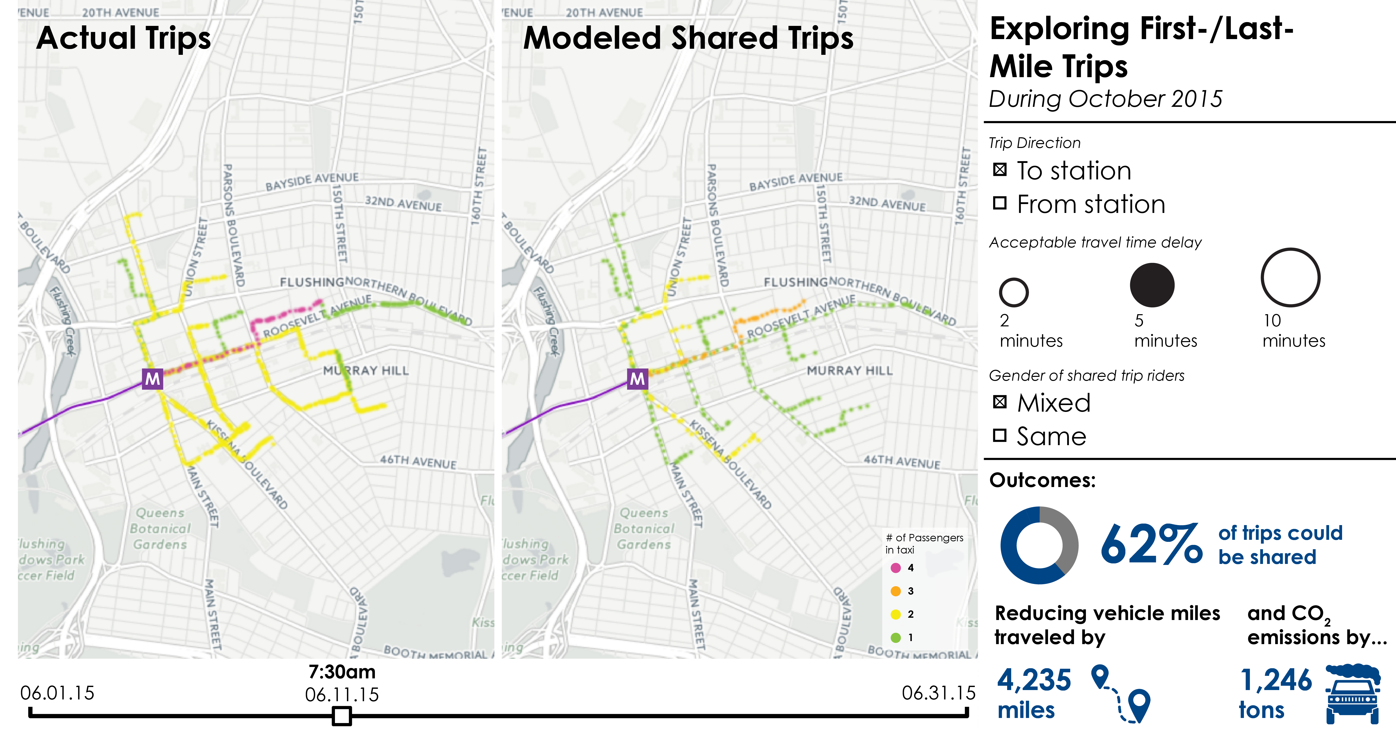
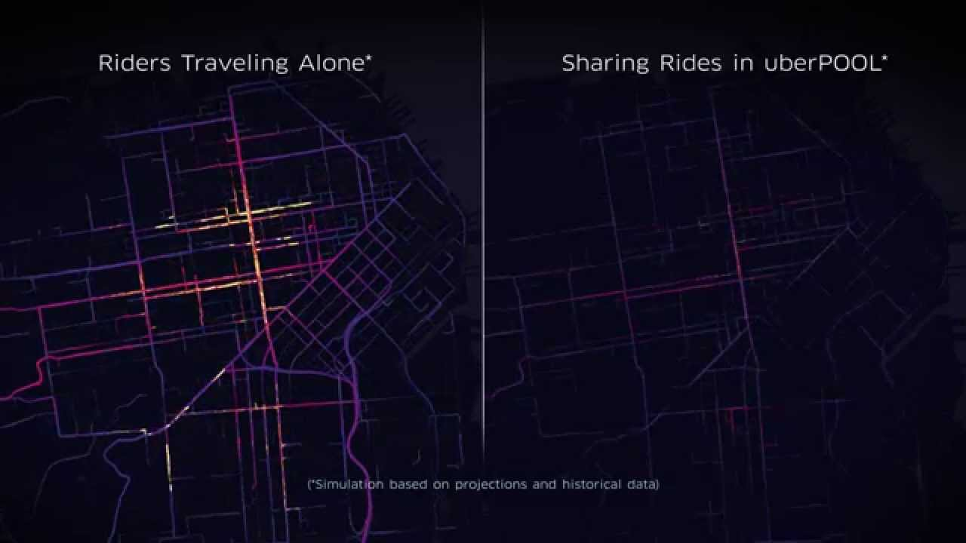
VISUALIZATION
Deliverable: two side-by-side animated panels showing the flow of taxi trips to/from a major metro terminal station in New York City, illustrating the difference in vehicle flow between no-sharing and with-sharing scenarios.
Control panel on the right allows users to explore several different parameters: direction of travel, travel time delay that people are willing to accept, and whether trips are matched only if passengers are of the same gender.
Outcomes section quantifies the corresponding impact of trip sharing
Uber has done a similar animation showing the effects of UberPOOL In San Francisco

Slide 4
DATA
METHOD
WORK PLAN
Final process review
Final presentation
New York City’s open taxi data include the following information for all trips:
pick-up and drop-off dates/times
pick-up and drop-off locations
trip distances
itemized fares, rate types, payment types
driver-reported passenger counts.
Our modelling will use one week of data from October 2015
Taxi trip data
Google
Maps API
JSON with route and
travel time info
Investigate algorithms (J & C)
3/14
3/21
3/28
4/4
4/11
4/18
4/25
5/2
5/9
Max matching
algorithm
Established database, query taxi data
GEOJSON file of
unshared taxi trip
trajectories
GEOJSON file of
shared taxi trip
trajectories
Trip routing
Build shareability network
CartoDB Torque to animate
visualization
Implement matching algorithm
Visualization
HTML, Javascript, D3 for
control panel elements
Policy implication; prep for final presentation

